Slide 1

Decoding working memory:
a predictive model of memory loads in the n-back task
Leptoceratops_Shoulder Mia Wu, Shanice St John, Erinni Mantouvalou, Polina Burmakina, Mohamed Shehata, Cem Karakuzu, Elisee Amegassi
Notes:
FE_of_HCP_project_subjects_split_updated.ipynb - Colaboratory (google.com)

Slide 2
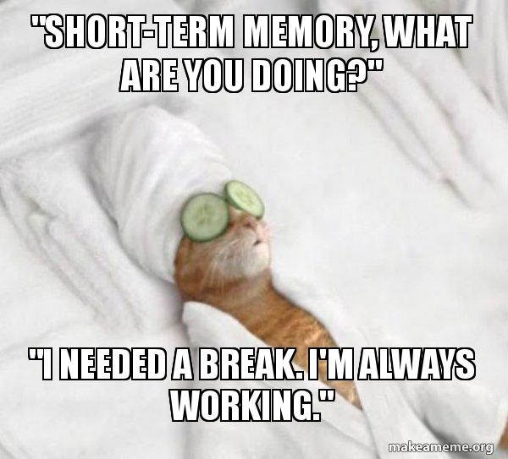
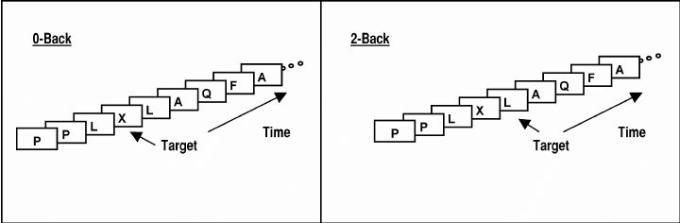
Working memory
A cognitive function that is essential for carrying out daily tasks
Store and processing of information
Limited capacity, relies on multiple brain regions
Assessment: N-back task
Memory load increase -> regional brain activity respond
Ladouceur et al., 2005
Notes:
The target in the 0-back control condition is any letter designated in the instructions (e.g., X) and the target in the 2-back memory-load condition is any repeat of a letter presented two trials back (e.g., L). mia

Slide 3
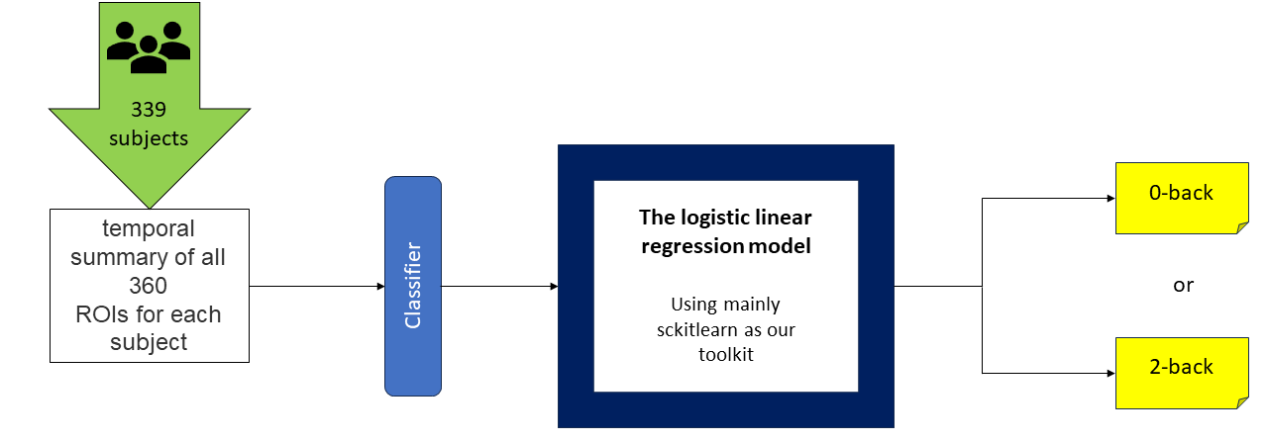
Goal
Is it possible to reveal the WM load by using signals from brain regions?
Investigate the possibility of using a logistic regression model to classify the load type of the N-back task based on the activity level derived from 360 brain regions

Slide 4
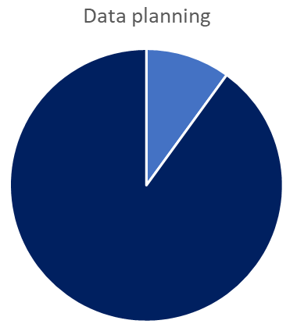
Methods and approach
X | Y
maximum value of ROIs activity for each parcel in a subject | 0-back or 2-back label (indicated as 0 for 0-back and 1 for the 2-back)
HCP dataset (0 back vs 2 back, four stimulus types: faces, body, tools, places) was used to retrieve the data for working memory task of 360 parcel of 339 subjects, then the data extraction was structured as the following:
data were split into 10% to be used for testing the accuracy and the other 90% were split into train and and test
10% for accuracy testing
90% model training
Notes:
fMRI relies blood oxygenation levels to measure activity in different areas of the brain
Features -> 4 types of stimuli
paulina
Classification -> pass or fail
N-back trials is one of the most commonly used tasks to measure and assess working memory efficiency.

Slide 5
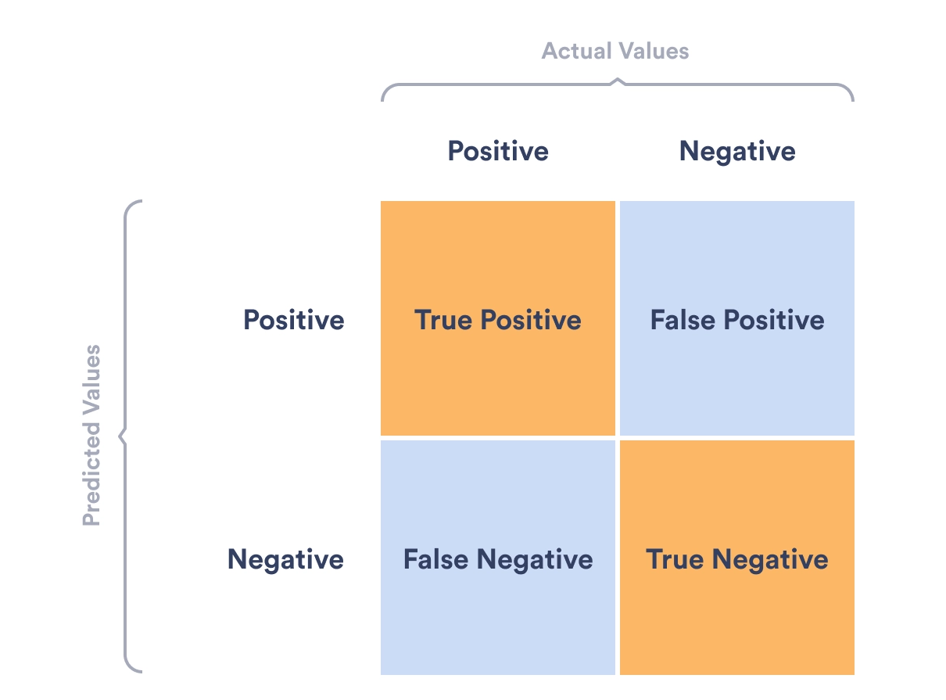
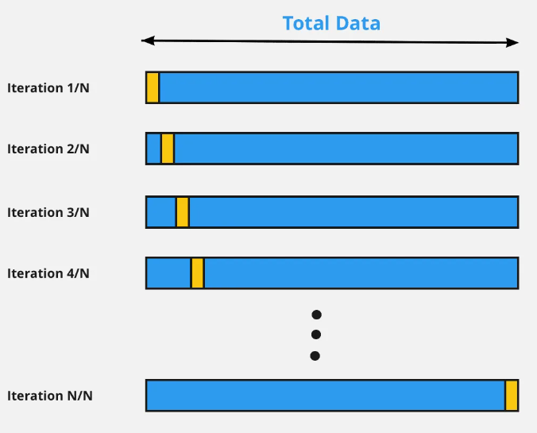
Methods and approach
Logistic regression was used to fit our data and predict labels then confusion matrix and classification report was performed to elevate the performance of the model
cross validation was performed to test prediction power and screen for problems such as overfitting
Notes:
fMRI relies blood oxygenation levels to measure activity in different areas of the brain
Features -> 4 types of stimuli
erinni
Classification -> pass or fail
N-back trials is one of the most commonly used tasks to measure and assess working memory efficiency.

Slide 6
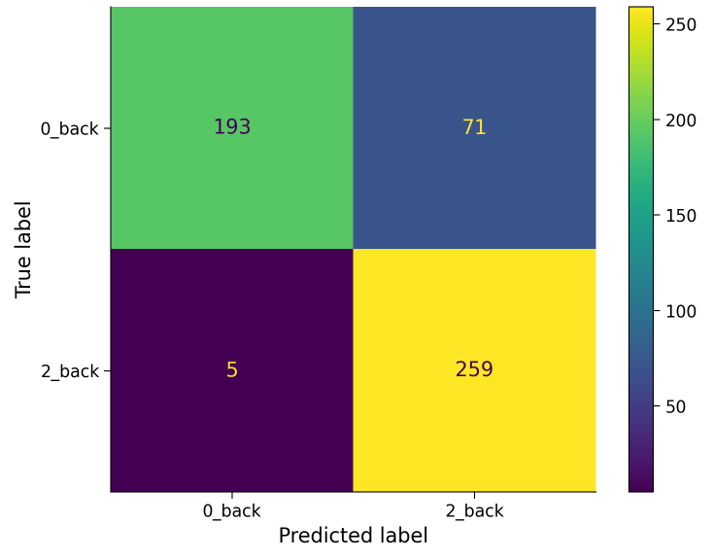
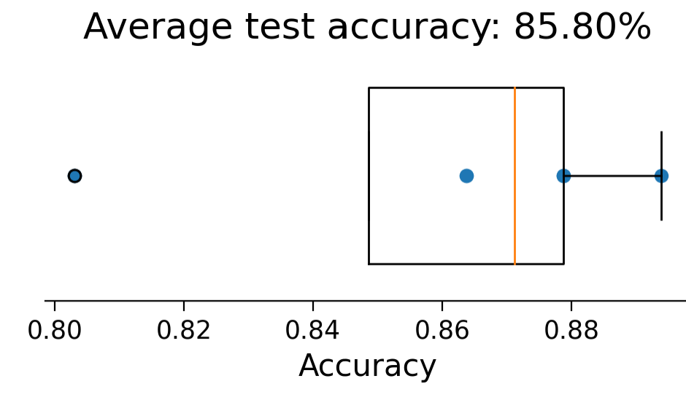
Results
Confusion matrix for all the conditions Cross-validation (k = 8)

Slide 7
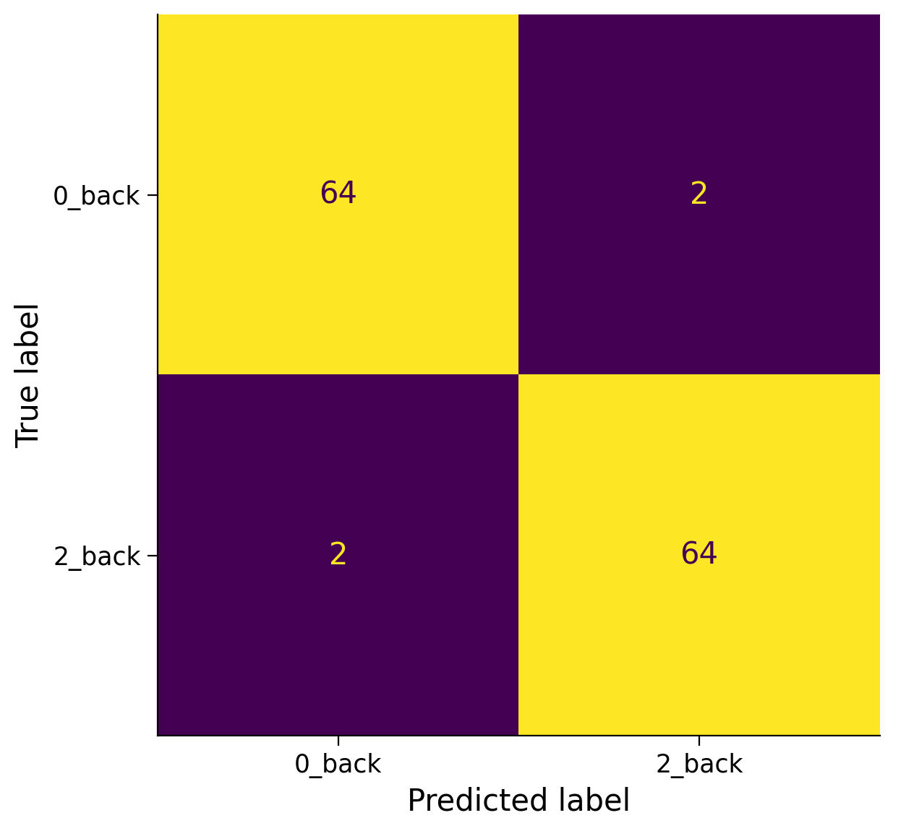
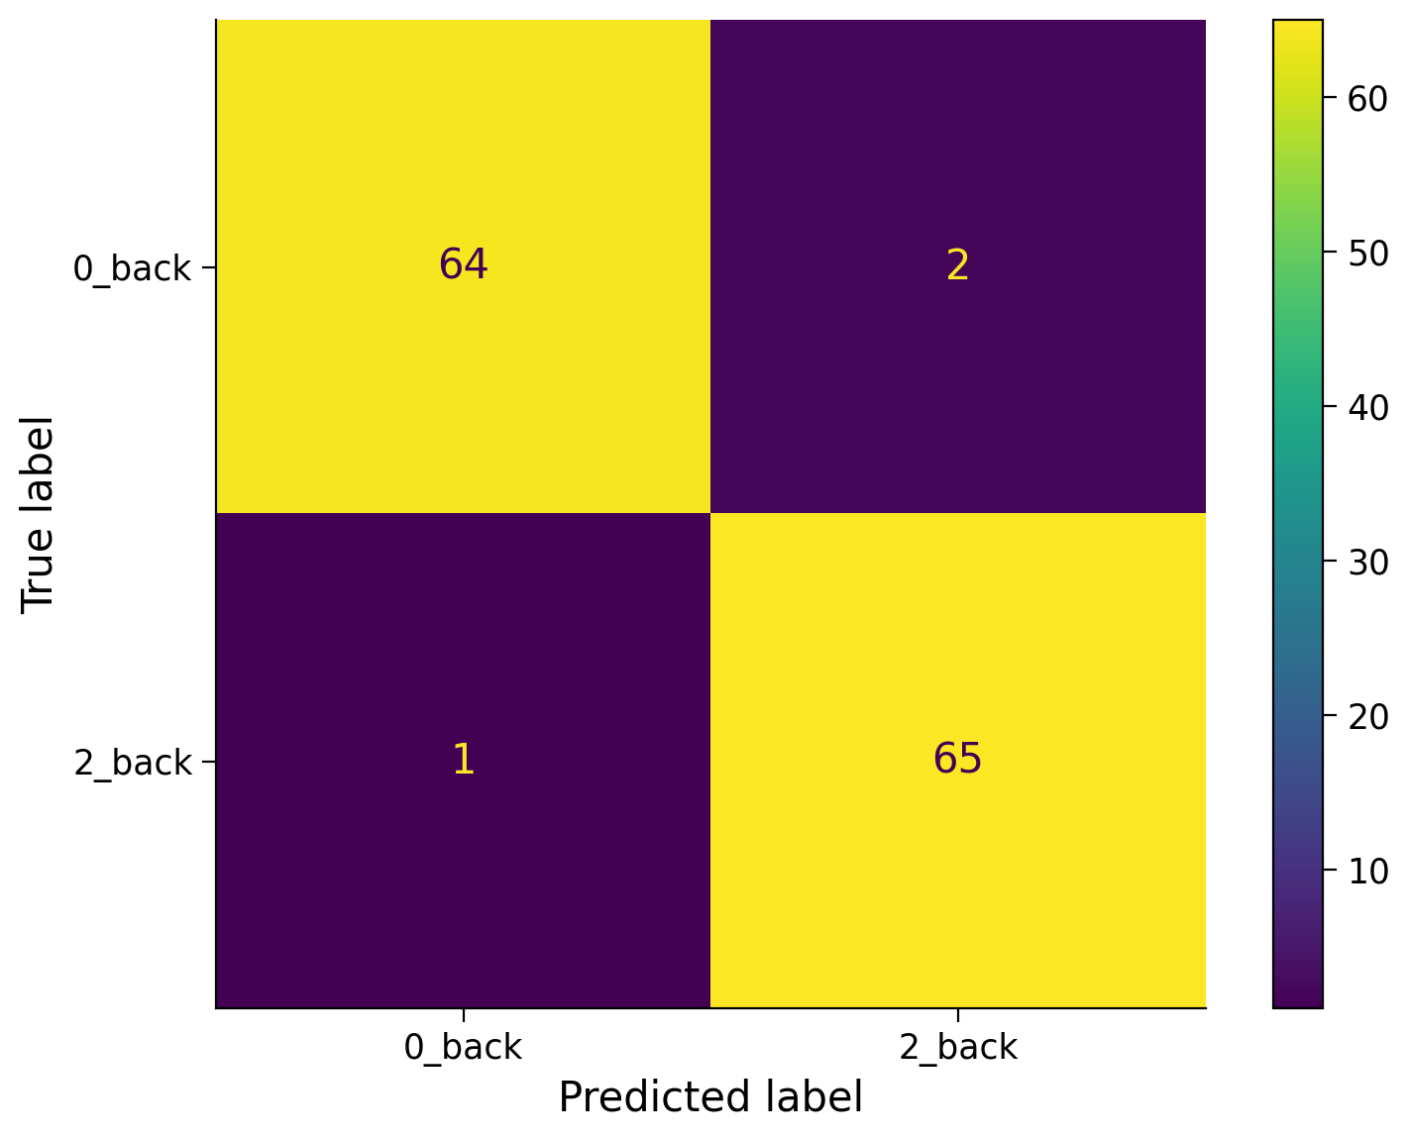
Results
Confusion Matrices for Individual Conditions
Faces
Body
Tools

Slide 8
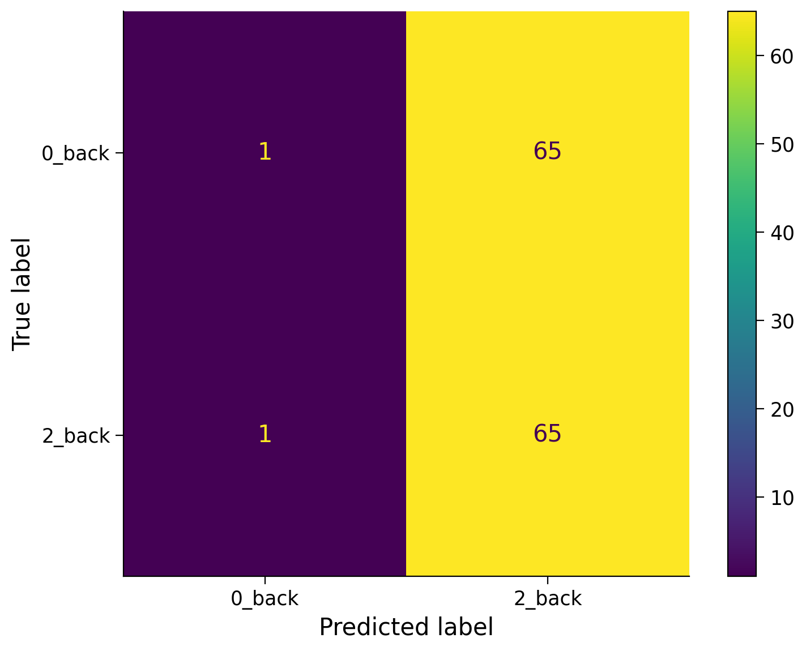


Results
Confusion Matrix for Places
Accuracy: 0.52

Slide 9
Finally
What is the percentage of accuracy?
According to the results, we found that 0-back and 2-back tasks can be differentiated by BOLD signals of ROIs. When dividing the stimuli as face, body, tools, and place, the tasks can be still separated with high accuracy except for ‘places.’ this maybe due to the high detail levels in places which require
Working memory activates particular regions in the brain and our predictive model is able predict load type. This distinction might be clearer, in the future studies using larger datasets.
Notes:
shanice?

Slide 10

Thanks for your time!
Notes:
FE_of_HCP_project_subjects_split_updated.ipynb - Colaboratory (google.com)

